Slide 1
British Airlines Predicting customer buying behaviour
Mohamad Ali Ghaddar

Slide 2
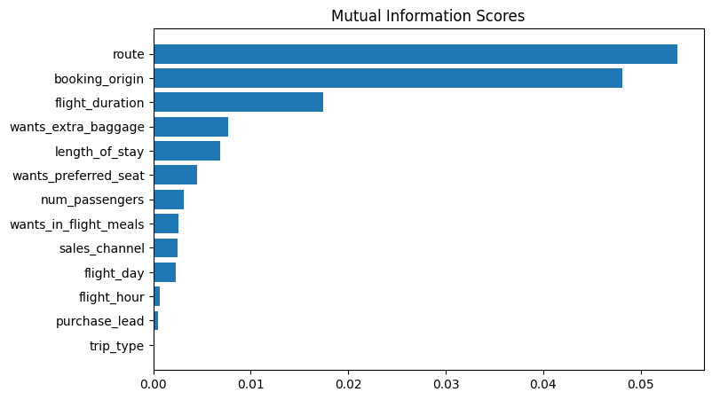
Analysis results: Top 5 features that affect customer behaviour are route, booking origin, flight duration, extra baggage and length of stay. The route and booking origin are the most crucial by far, they play a huge role for our clients in choosing flights, Accuracy of our model is 85,37%. AUC score of our model is 0,57. We should provide our customers with the most optimal flights for our 5 most precious features, that way we can have more clients,

